Slide 1
Vlaams Supercomputer Centrum

Slide 2
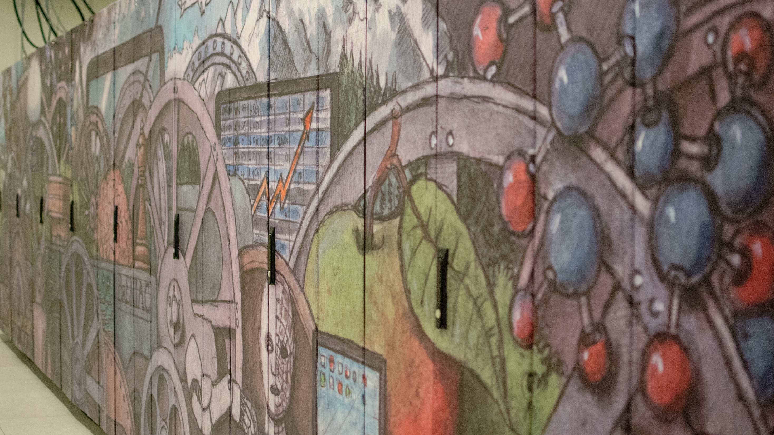
Supercomputers and
Parallel computing

Slide 3

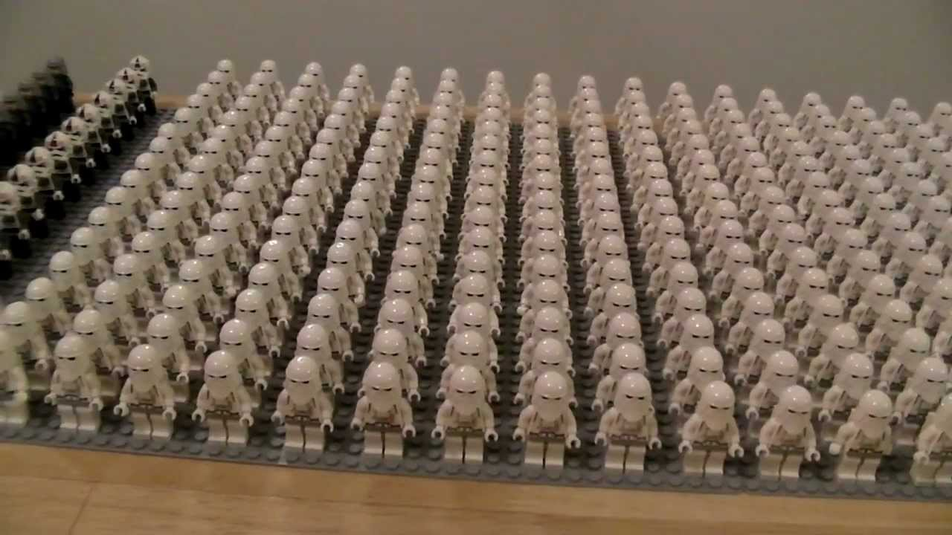

Supercomputer ?
VS

Slide 4
Bird’s eye view of a cluster
Compute nodes
Many independent computers, each with its own operating system, memory, hard disk,…
Accessed via login nodes
For job submission, debugging, pre/post processing
Shared resources: everyone works on the same (set of) login nodes
Infiniband interconnect
Cluster
Researchers
Administration - queue system, job scheduler, user management,…
Login nodes
Service nodes
Researchers
Storage
Notes:
Do we add GPFS integration with VIC3?

Slide 5
Parallel computing
Serial:
one program, on one core
’Embarrassingly parallel’ problems:
lots of runs of one program, with different parameters
Hadoop, Spark
Problems that require ’real’ parallel algorithms
OpenMP
MPI : Message Passing Interface
GPU/Accelerator parallelism interface

Slide 6
What a cluster is not…
An all-powerful and super smart computer that will automatically:
Run your application much faster
Run your application in parallel
For that you will need to do some extra work

Slide 7
Challenges
Transition to HPC
Moving data to the HPC infrastructure
Software
Existing tools are often not HPC-compatible
Often do not scale (algorithm productivity is not straightforward proportional to the processing power)
General “big data” algorithms often have to be specifically adapted for NGS compute and analysis
Post-processing and analysis of the results
Analysis of massive datasets is not trivial
Query of the results
Generating reports

Slide 8
Where to find supercomputers?

Slide 9



HPC OPTIONS
In-house
Cloud
VSC

Slide 10

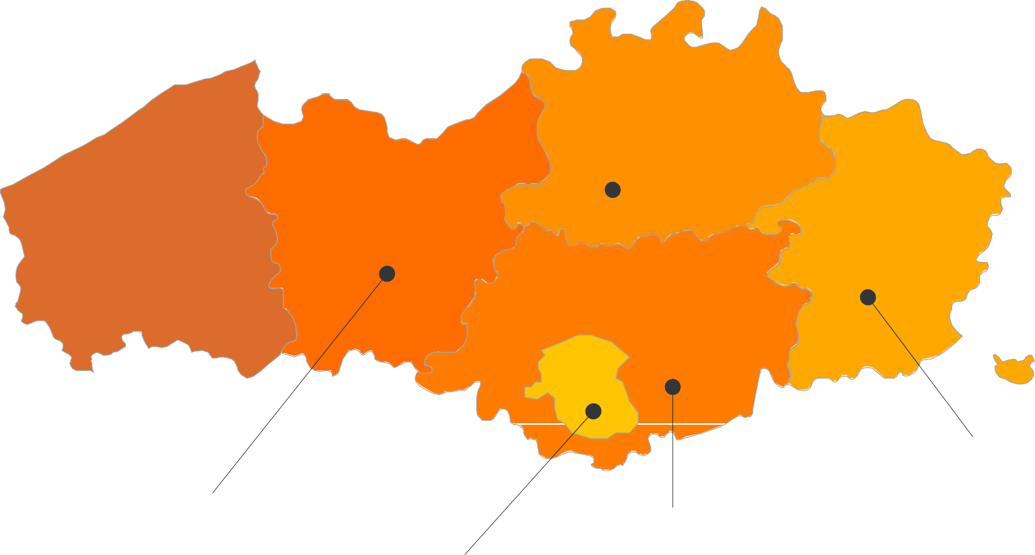


















VSC partnership
A n t w e r p e n
O o s t
V l a a n d e r e n
Supported by
W e s t
V l a a n d e r e n
L i m b u r g
V l a a m s - B r a b a n t
B r u s s e l
Started 2007
vscentrum.be
4

Slide 11

HPC tiering model
Tier-0
European
Tier-1
Regional National
Vlaams Supercomputer Centrum
Tier-2
University
Tier-3
Desktop or under het desk …
vscentrum.be
4

Slide 12









VSC Environment
Structural
Funding
Tier-2
Since 2013
Tier-1
SaaS
2018-2022
Tier-2

Slide 13
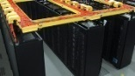







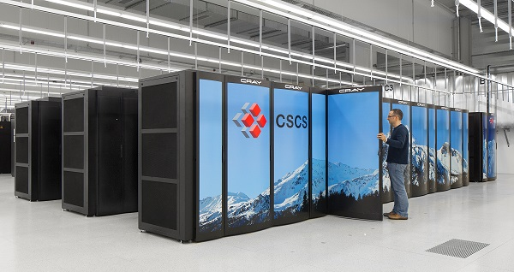

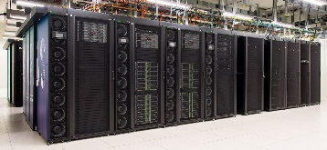




VSC HPC environment
Tier-0
Europe
Project proposals
Tier-1
Flanders
BrENIAC
Access for all academics and students
Tier-2
University
STEVIN | HYDRA | HOPPER/LEIBNIZ | THINKING/GENIUS

Slide 14
VSC Services
Basic support
Monitoring and reporting
Helpdesk
Application support
Installation and porting
Optimisation and debugging
Benchmarking
Workflows and best practices
Training
Documentation and tutorials
Scheduled trainings / workshops
On request workshops
One-to-one sessions

Slide 15
VSC training
Training and courses at VSC
Introductory
Intermediate
Advanced
Specialized
Infosession

Slide 16
VSC training
Training and courses at VSC
Seasonal schools
MPI
OpenMP
Python for HPC
optimizatiopn
Python for Machine Learning
Fortran for programmers
Linux tools
Debugging techniques
Linux scripting
Python for Datascience
C++ for scientific computing
Version control
Linux for HPC
Containers
Worker/Atools
Make intro
Linux
HPC intro
notebooks

Slide 17

WWW
www.vscentrum.be
Documentation! Answers >80% of your questions
Very rich suite of courses every academic year

Slide 18
More about the hardware

Slide 19

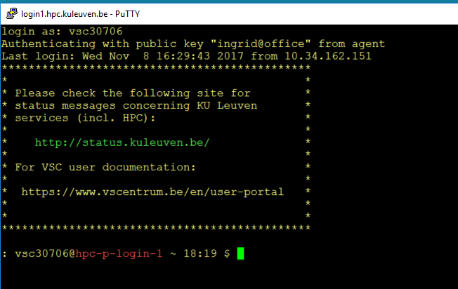

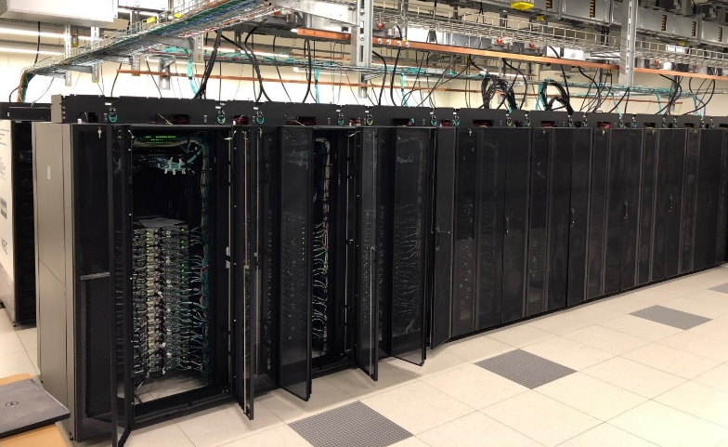
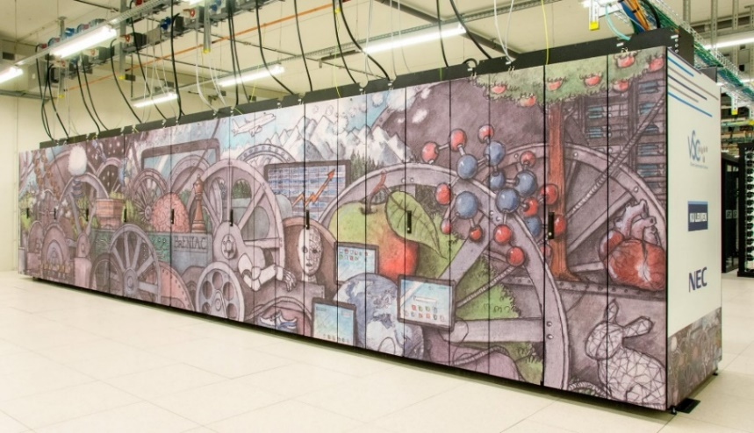


Tier-1 compute resources
580 nodes – Broadwell
2x Intel E5-2680v4 14c 2.4GHz
128/256 GB RAM
408 nodes – Skylake
2x Intel Gold 6132 14c 2.6GHz
192GB
NX Client
SSH Client
580 nodes – Broadwell
2x Intel E5-2680v4 14c 2.4GHz
128/256 GB RAM
408 nodes – Skylake
2x Intel Gold 6132 14c 2.6GHz
192GB
IB network
Eth network
GPFS – 1,3 PiB
BW – 20 GB/s
NFS

Slide 20
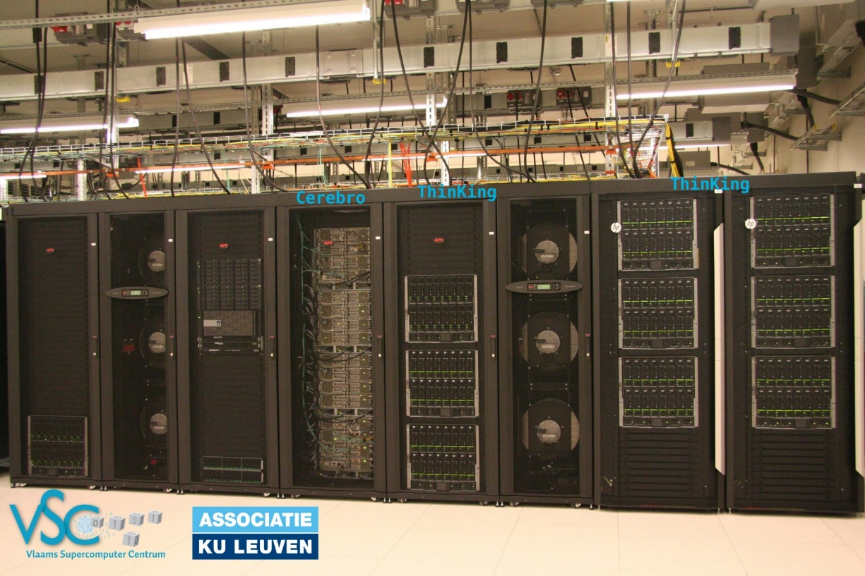



Tier-2 resources KU Leuven
Compute nodes
Large memory nodes
GPU nodes
Exp nodes
Thinking:
176+32 Ivybridge 20 cores 64/128GB
48 +86 Haswells 24 cores 64.128 GB
Genius:
96 Skylale 36 cores 192GB
120 CascadeLake 36 c 192 GB
Genius:
10 Skylake 36c 768GB
1 Superdome 112c 6 TB
Genius:
20 Skylake 36c 192 GB/4 P100 16GB
2 CascadeLake 36c 192GB/8 V100 32GB
Genius:
4 AMD Naples 64c 256 GB

Slide 21
System comparison
 | Tier 2 |  |  |  | Tier 1
 | ThinKing |  | Genius |  | BrENIAC
Total nodes | 176 / 32 | 48 / 96 | 86 / 10 | 120 | 580 | 408
Processor type | Ivybridge | Haswell | SkyLake Gold 6140 | Cascade Lake | Broadwell E5-2680v4 | SkyLake Gold 6132
Base Clock Speed | 2.8 GHz | 2.5 GHz | 2.3 GHz | 2.6 GHz | 2.4 GHz | 2.6Ghz
Cores per node | 20 | 24 | 36 | 36 | 28 | 28
Total cores | 4,160 | 3,456 | 3,456 | 4,320 | 27,664
Memory per node (GB) | 64 / 128 | 64 / 96 | 192 / 768 | 192 | 128 / 256 | 192
Memory per core (GB) | 3.2 / 6.4 | 2.7 / 5.3 | 5.3 / 21.3 | 5.3 | 4.5 / 9 | 6.8
Peak performance (Flops/cycle) | 4 DP FLOPs/cycle: 4-wide AVX addition OR 4-wide AVX multiplication | 8 DP FLOPs/cycle: 4-wide FMA (fused multiply-add) instructions AVX2 | 16 DP FLOPs/cycle: 8-wide FMA (fused multiply-add) instructions AVX-512 | 16 DP FLOPs/cycle: 8-wide FMA (fused multiply-add) instructions AVX-512 | 8 DP FLOPs/cycle: 4-wide FMA (fused multiply-add) instructions AVX2 | 16 DP FLOPs/cycle: 8-wide FMA (fused multiply-add) instructions AVX-512
Network | Infiniband QDR 2:1 | Infiniband FDR | Infiniband EDR | Infiniband EDR | Infiniband EDR
Cache (L1 KB/L2 KB/L3 MB) | 10x(32i+32d) / 10x256 / 25 MB | 12x(32i+32d) / 12x256 / 30MB | 18x(32i+32d) / 18x1024 / 25 MB | 18x(32i+32d) / 18x1024 / 25 MB | 14x(32i+32d) / 14x 256 / 35 MB | 18x(32i+32d) / 18x1024 / 25 MB
Notes:
SkyLake : Xeon G 6140
Cascade lake : Xeon G 6240

Slide 22
How to start ?

Slide 23
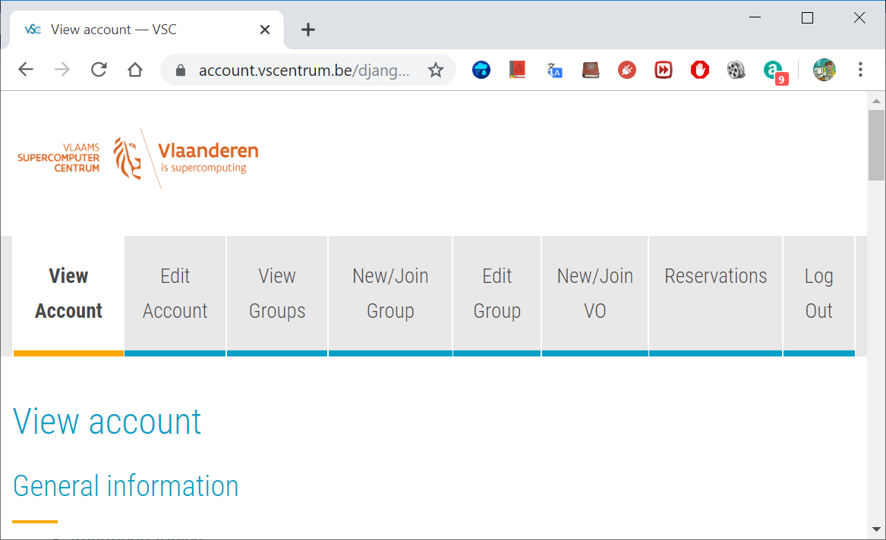
Joining VSC – request VSC account
You need to request a VSC account (you need an institute account at one of the universities KU Leuven => u-,s-,r-number or external KU Leuven account)
Create a secure (4096 bit) SSH key pairs Upload it on the account page: account.vscentrum.be
Default storage: 3 GB $VSC_HOME 75 GB $VSC_DATA 100 GB $VSC_SCRATCH
Request introductory credits (2000 free credits for 6 months)
Service Desk If you have a question and/or problem, you can contact HPC support team directly via hpcinfo@kuleuven.be

Slide 24
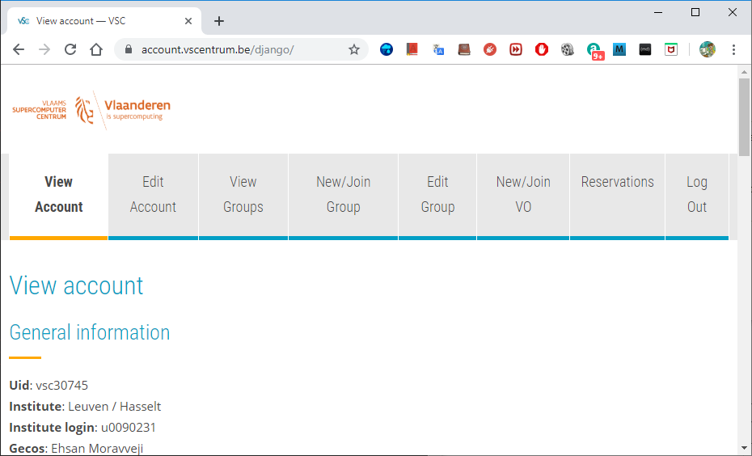
To manage your VSC account
Upload more SSH public keys
Upload SSH Key Request account
Create or request to join a new group
Moderate your own groups (add/remove users)

Slide 25
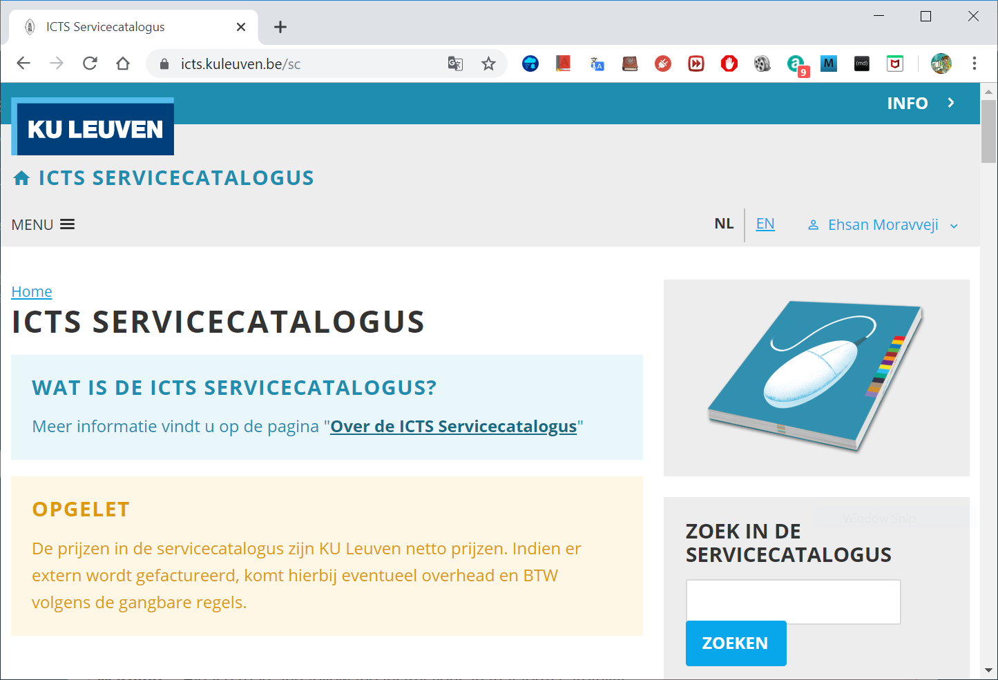
Joining VSC – for project leaders
Request project credits (for supervisors and project leaders)
You need to create a VSC group Add users to the group to give them access to use credits Fill out the request form
You can join an existing group
Extra storage requests
All service costs (compute and storage) are all explained Go to ICTS service catalogus: https://icts.kuleuven.be/sc Click on High Performance Computing (NL/EN)
Talk to us for support via hpcinfo@kuleuven.be

Slide 26
How does the cluster work?

Slide 27
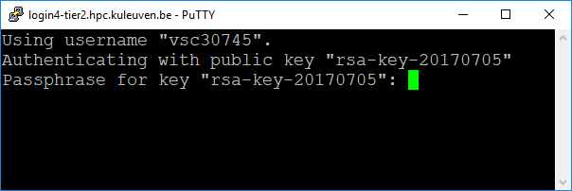
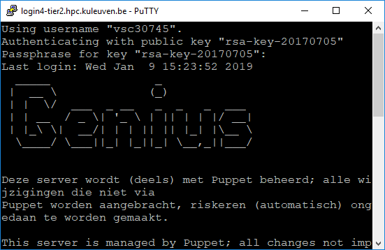
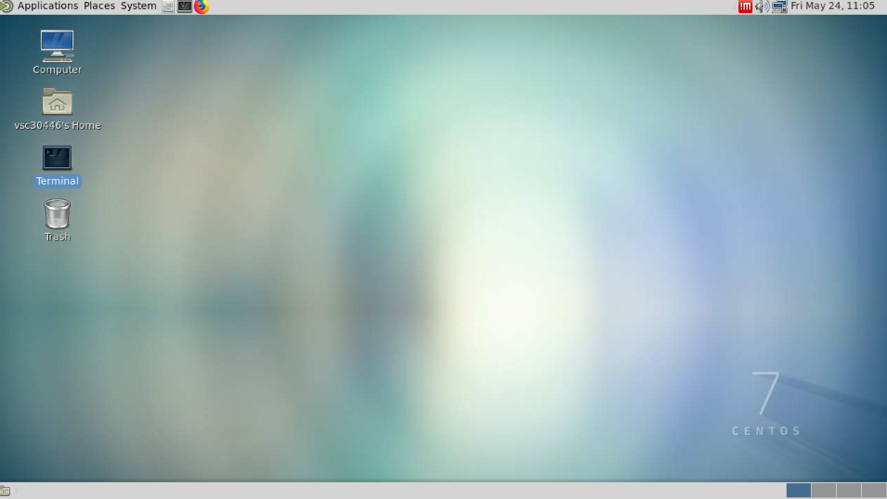
Access the machine
Text-based Windows: PuTTY, MobaXterm Linux/Mac: terminal
No X-Forwarding
login1-tier2.hpc.kuleuven.be
login.hpc.kuleuven.be
login2-tier2.hpc.kuleuven.be
login-genius.hpc.kuleuven.be
Nvidia Quadro P6000
login3-tier2.hpc.kuleuven.be
login4-tier2.hpc.kuleuven.be
NX
Nomachine
Nvidia Quadro P6000
login3-tier2.hpc.kuleuven.be
nx.hpc.kuleuven.be
login4-tier2.hpc.kuleuven.be

Slide 28
Submit a Job

Slide 29
Resource management and schedulling
Resource manager knows
all available resources
Which jobs are ready to run
Job scheduler decides when and where to run jobs using a priority queue
Queries resource manager for runnable jobs
Tries to optimize resource usage and sets priorities
Orders resource manager to start (or stop …) jobs

Slide 30
Job scheduler: Moab
the whole procedure is redone in every iteration (every minute or so)
a job can lose its reservation, if a higher priority job gets submitted in the meantime
a job can start earlier, if a job ends earlier than specified
the “showstart” command gives a startime estimate obtained in the last iteration

Slide 31
Types of jobs
Batch jobs: qsub mypbs.sh
allow for the most efficient use of the infrastructure
a bash shell script that is executed on a compute node
are placed in the queue, and the user can forget about it until it is finished.
Interactive jobs: qsub -I mypbs.sh
are intended to work on one or more compute nodes interactively
useful for software development, debugging, application profiling
basically, one gets a linux shell on one of the compute nodes.

Slide 32
Specifying resources that you need
Submit a resource request
For Resource List
Cores per Server
Max. Runtime
$> qsub –I –l nodes=1:ppn=28,pmem=4gb,walltime=12:00:00 –A <project name>
For Interactive Jobs
One server
Memory per Core
Project Name for Computing Credits
Remarks
Specifying <project name> for credits is mandatory, e.g.: –A

Slide 33
Specify needed resouces in a job script
Shebang
PBS scripts do not need to be executable – they are submitted to the queue and executed non-interactively.
#!/bin/bash
#PBS -l walltime=00:10:00
#PBS -l nodes=1:ppn=28
#PBS -l pmem=4gb
#PBS -N testjob
#PBS -A lp_myproject
#PBS -m abe
#PBS -M my.name@kuleuven.be
module purge
module load R/3.2.5-intel-2016a-bare
cp /apps/leuven/training/HPC-intro/cpujob.pbs $VSC_SCRATCH
cd $PBS_O_WORKDIR
Rscript run.r
echo I am done
Resource List
Module load(s)
Move data
Execute commands

Slide 34












Software stack available
Applications
…
Development
…
Toolchains
OpenMPI Intel MPI
OpenBlas MKL
Cluster management
queues
Commands
support scripts
node features
System
Module system
Environment variables: $VSC_XXXXl
login.hpc.site.be

Slide 35
Install your own
Linux OS
Check the license
Conda installations

Slide 36
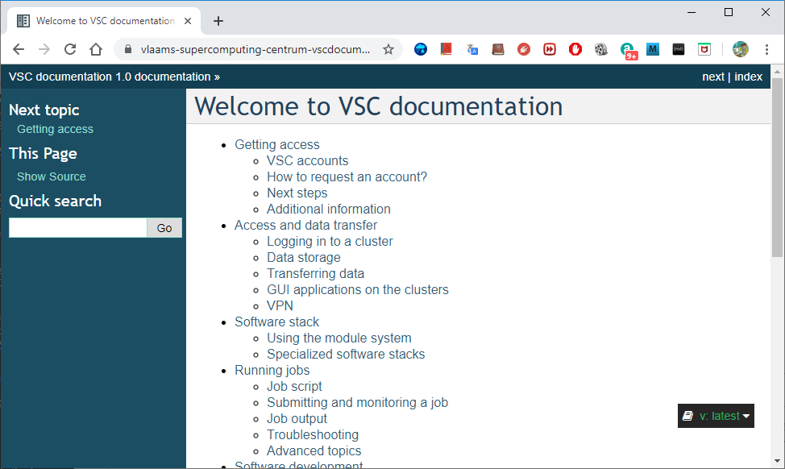
User documentation

Slide 37
User documentation
Answers most of the user questions

Slide 38
Get started

Slide 39

Questions
Helpdesk:
hpcinfo@kuleuven.be
VSC web site: http://www.vscentrum.be/
VSC documentation
VSC agenda: training sessions, events
https://hpcleuven.github.io/HPC-intro/

